Slide 1
Chapter 3
The Relational
Data Model

Slide 2
Topics
Data and Its Structure
Three Levels of Abstraction
  Physical Data Level
  Conceptual Data Level
  External Data Level
Data Model
Relational Model
Integrity Constraints
SQL
1-<number>

Slide 3
Data and Its Structure
Data is actually stored as bits
  But it is difficult to work with data at this level
  It is convenient to view data at different levels of abstraction (Fig. 3-1)
Schema
  Description of data at some abstraction level. Each level has its own schema
Three schemas
  Physical, Conceptual, and External
1-<number>

Slide 4
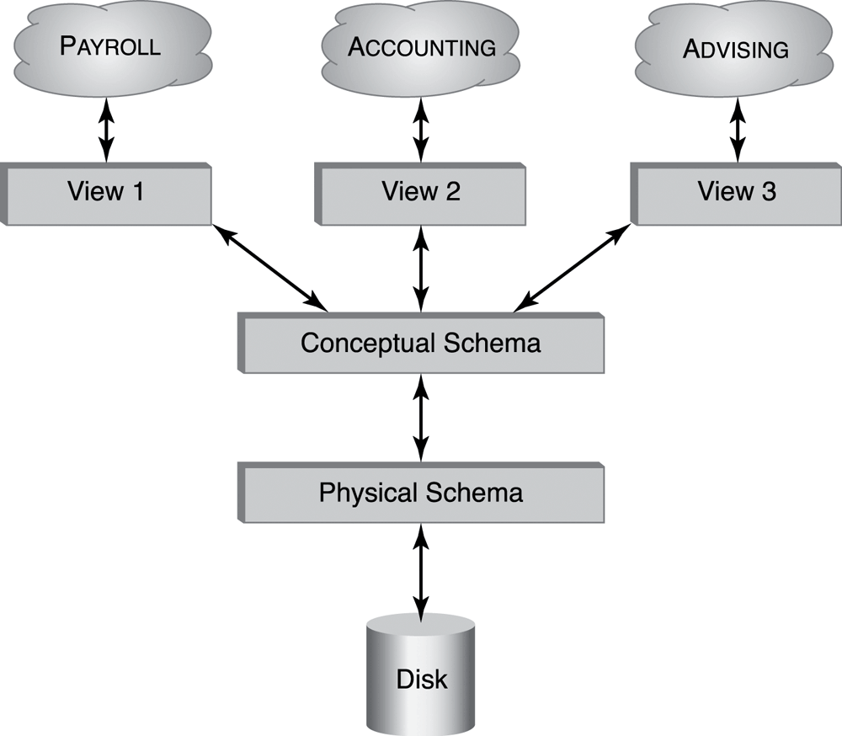
Levels of Abstraction
External
schemas
Fig. 3-1 Different levels
of abstraction
1-<number>

Slide 5
Physical Data Level
Physical schema
  Describes details of how data is stored: tracks, cylinders, indices etc
  Early applications worked at this level – explicitly dealt with details
Problem:
  Routines were hard-coded to deal with physical representation
    Changes to data structure difficult to make
    Application code becomes complex since it must deal with details
    Rapid implementation of new features impossible
1-<number>

Slide 6
Conceptual Data Level 1
Hides details
  In the relational model, the conceptual schema presents data as a set of relations (tables)
  DBMS maps from conceptual to physical schema automatically
Physical data independence
  Physical schema can be changed without changing application
  DBMS would change mapping from conceptual to physical transparently
1-<number>

Slide 7
Conceptual Data Level 2
Conceptual view of data
Application
Physical view of data
DBMS
1-<number>

Slide 8
External Data Level 1
In the relational model, the external schema also presents data as a set of relations
An external schema specifies a view of the data in terms of the conceptual level
  It is tailored to the needs of a particular category of users
  Portions of stored data should not be seen by some users
    Students should not see their files in full.
    Faculty should not see billing data.
  Information that can be derived from stored data might be viewed as if it were stored
    GPA not stored, but calculated when needed.
1-<number>

Slide 9
External Data Level 2
Application is written in terms of an external schema
  A view is computed when accessed (not stored)
  Different external schemas can be provided to different categories of users
  Translation from external to conceptual done automatically by DBMS at run time
Conceptual data independence
  Conceptual schema can be changed without changing application
  Mapping from external to conceptual must be changed
1-<number>

Slide 10
Data Model
Schema: description of data at some level (e.g., tables, attributes, constraints, domains)
Model: tools and language for describing
  Conceptual and external schema
    Data definition language (DDL)
  Integrity constraints, domains (DDL)
  Operations on data
    Data manipulation language (DML)
  Directives that influence the physical schema (affects performance, not semantics)
    Storage definition language (SDL)
1-<number>

Slide 11
Relational Model
A particular way of structuring data (using relations)
Simple
Mathematically based
  Expressions (≡ queries) can be analyzed by DBMS
  Queries are transformed to equivalent expressions automatically (query optimizer)
    Optimizers have limits (=> programmer needs to know how queries are evaluated and optimized)
1-<number>

Slide 12
Relation Schema
Relation name
Attribute names & domains
Integrity constraints like
  The values of a particular attribute in all tuples are unique
  The values of a particular attribute in all tuples are greater than 0
Default values
1-<number>

Slide 13
Relation Instance
Relation is a set of tuples
  Tuple ordering immaterial
  No duplicates
  Cardinality of relation = number of tuples
All tuples in a relation have the same structure; constructed from the same set of attributes
  Attributes are named (ordering is immaterial)
  Value of an attribute is drawn from the attribute’s domain
    There is also a special value null (value unknown or undefined), which belongs to no domain
  Arity of relation = number of attributes
1-<number>

Slide 14
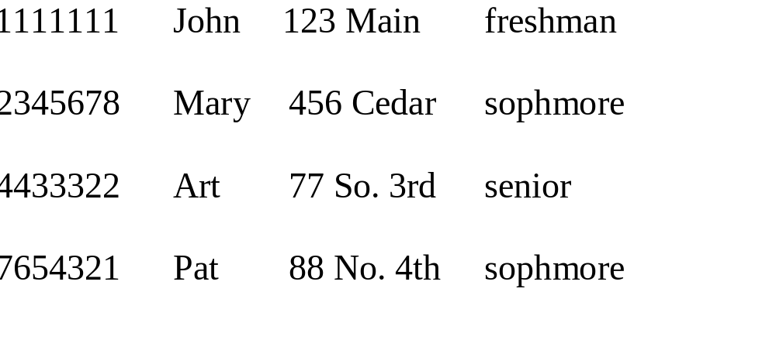
Relation Instance (Example)
Id Name Address Status
Student
1-<number>

Slide 15
Relational Database
Finite set of relations
Each relation consists of a schema and an instance
Database schema = set of relation schemas constraints among relations (inter-relational constraints)
Database instance = set of (corresponding) relation instances
1-<number>

Slide 16
Relational Database (Example)
Database Schema
  Student (Id: INT, Name: STRING, Address: STRING,
  Status: STRING)
  Professor (Id: INT, Name: STRING, DeptId: DEPTS)
  Course (DeptId: DEPTS, CrsName: STRING,
  CrsCode: COURSES)
  Transcript (CrsCode: COURSES, StudId: INT,
  Grade: GRADES, Semester: SEMESTERS)
  Department(DeptId: DEPTS, Name: STRING)
1-<number>

Slide 17
Integrity Constraints
Part of schema
Restriction on state (or of sequence of states) of database
Enforced by DBMS
Intra-relational - involve only one relation
  Part of relation schema
  e.g., all Ids are unique
Inter-relational - involve several relations
  Part of relation schema or database schema
1-<number>

Slide 18
Constraint Checking
Automatically checked by DBMS
Protects database from errors
Enforces enterprise rules
1-<number>

Slide 19
Kinds of Integrity Constraints
Static – restricts legal states of database
  Syntactic (structural)
    e.g., all values in a column must be unique
  Semantic (involve meaning of attributes)
    e.g., cannot register for more than 18 credits
Dynamic – limitation on sequences of database states
    e.g., cannot raise salary by more than 5%
1-<number>

Slide 20
Key Constraint
Key constraint
  A key constraint is a sequence of attributes A₁,…,A_{n} (n=1 possible) of a relation schema, S, with the following property:
  Uniquess: A relation instance s of S satisfies the key constraint
  iff at most one row in s can contain a particular set of values, a₁,…,a_{n}, for the attributes A₁,…,A_{n}
  Minimality: no subset of A₁,…,A_{n} is a key constraint
Key
  Set of attributes mentioned in a key constraint
    e.g., Id in Student,
    e.g., (StudId, CrsCode, Semester) in Transcript
  It is minimal: no subset of a key is a key
    (Id, Name) is not a key of Student
1-<number>

Slide 21
Key Constraint (cont’d)
Superkey - set of attributes containing key
  (Id, Name) is a superkey of Student
Every relation has a key
Relation can have several keys:
  Primary key: Id in Student (can’t be null)
  Candidate key: (Name, Address) in Student
1-<number>

Slide 22
Foreign Key Constraint
Referential integrity: Item named in one relation must refer to tuples that describe that item in another
  Transcript (CrsCode) references Course(CrsCode )
  Professor(DeptId) references Department(DeptId)
Foreign key
Attribute A₁ is a foreign key of R1 referring to attribute A₂ in R2, if whenever there is a value v of A₁, there is a tuple of R2 in which A₂ has value v, and A₂ is a key of R2
  This is a special case of referential integrity: A₂ must be a candidate key of R2 (e.g., CrsCode is a key of Course in the above)
  If no row exists in R2 => violation of referential integrity
  Not all rows of R2 need to be referenced: relationship is not symmetric (e.g., some course might not be taught)
  Value of a foreign key might not be specified (DeptId column of some professor might be null)
1-<number>

Slide 23
Foreign Key Constraint (Example)
A₂
v3
v5
v1
v6
v2
v7
v4
A₁
v1
v2
v3
v4
null
v3
R1
R2
Foreign key
Candidate key
1-<number>

Slide 24
Foreign Key (cont’d)
Names of the attrs A₁ and A₂ need not be the same
  With tables:
  ProfId attribute of Teaching references Id attribute of Professor
R1 and R2 need not be distinct
  Employee(Id:INT, MgrId:INT, ….)
    Employee(MgrId) references Employee(Id)
  Every manager is also an employee and hence has a unique row in Employee
Teaching(CrsCode: COURSES, Sem: SEMESTERS, ProfId: INT)
Professor(Id: INT, Name: STRING, DeptId: DEPTS)
1-<number>

Slide 25
Foreign Key (cont’d)
Foreign key might consist of several columns
  (CrsCode, Semester) of Transcript references (CrsCode, Semester) of Teaching
R1(A₁, …A_{n}) references R2(B₁, …B_{n})
  A_{i} and B_{i} must have same domains (although not necessarily the same names)
  B₁,…,B_{n} must be a candidate key of R2
1-<number>

Slide 26
Inclusion Dependency
Referential integrity constraint that is not a foreign key constraint
Teaching(CrsCode, Semester) references Transcript(CrsCode, Semester)
(no empty classes allowed)
Target attributes do not form a candidate key in Transcript (StudId missing)
No simple enforcement mechanism for inclusion dependencies in SQL (requires assertions -- later)
1-<number>

Slide 27
Given Examples for following of Integrity Constraints (上課小測驗)
Static – restricts legal states of database
  Syntactic (structural)
  Semantic (involve meaning of attributes)
Dynamic – limitation on sequences of DB states
Intra-relational - involve only one relation
  Part of relation schema
Inter-relational - involve several relations
  Part of relation schema or database schema
1-<number>

Slide 28
SQL
Language for describing database schema and operations on tables
Data Definition Language (DDL): sublanguage of SQL for describing schema
1-<number>

Slide 29
Tables
SQL entity that corresponds to a relation
An element of the database schema
SQL-92 is currently the most supported standard but is now superseded by SQL:1999 and SQL:2003
Database vendors generally deviate from the standard, but eventually converge
1-<number>

Slide 30
SQL Standards
年份 | 名字 | 別名 | 注釋
1986 | SQL-86 | SQL-87 | ANSI首次標準化
1989 | SQL-89 | FIPS 127-1 | 小修改，增加了integrity constraint
1992 | SQL-92 | SQL2, FIPS 127-2 | 大修改，成為現代SQL的基礎
1999 | SQL:1999 | SQL3 | 增加了正規表示式符合、遞迴查詢（傳遞閉包）、資料庫觸發器、程序式與控制流語句、非純量類型(arrays)、物件導向特性。在Java中嵌入SQL(SQL/OLB)及其逆(SQL/JRT)
2003 | SQL:2003 |  | 增加XML相關特性(SQL/XML)、window functions、標準化sequences、自動產生值的列。對SQL:1999的新特性重新描述其內涵。
2006 | SQL:2006 |  | 匯入/匯出XML資料與SQL資料庫。XQuery
2008 | SQL:2008 |  | 在cursor之外的ORDER BY語句。INSTEAD OF觸發器。TRUNCATE語句。FETCH子句
2011 | SQL:2011 |  | 增加時態資料(PERIOD FOR)。增強了window functions與FETCH子句
2016 | SQL:2016 |  | 增加行模式符合、多型表函式、JSON。
1-<number>

Slide 31
SQL Sublanguages
Data Definition Language (DDL)
  資料定義語言
  CREATE，ALTER，DROP，DECLARE
Data Manipulation Language (DML)
  資料操作語言
  SELECT，DELETE，UPDATE，INSERT
Data Control Language (DCL)
  資料控制語言
  GRANT，REVOKE，COMMIT，ROLLBACK
    權限：CONNECT, SELECT, INSERT, UPDATE, DELETE, EXECUTE, USAGE, REFERENCES
1-<number>

Slide 32
Table Declaration
CREATE TABLE Student (
Id: INTEGER,
Name: CHAR(20),
Address: CHAR(50),
Status: CHAR(10)
)
Id
Name
Address
Status
101222333 John 10 Cedar St Freshman
234567890 Mary 22 Main St Sophomore
Student
1-<number>

Slide 33
Primary/Candidate Keys
CREATE TABLE Course (
CrsCode CHAR(6),
CrsName CHAR(20),
DeptId CHAR(4),
Descr CHAR(100),
PRIMARY KEY (CrsCode),
UNIQUE (DeptId, CrsName) -- candidate key
)
Comments start with 2 dashes
1-<number>

Slide 34
Null
Problem: Not all information might be known when row is inserted (e.g., Grade might be missing from Transcript)
A column might not be applicable for a particular row (e.g., MaidenName if row describes a male)
Solution: Use place holder – null
  Not a value of any domain (although called null value)
    Indicates the absence of a value
  Not allowed in certain situations
    Primary keys and columns constrained by NOT NULL
1-<number>

Slide 35
Default Value
Value to be assigned if attribute value in a row
is not specified
CREATE TABLE Student (
Id INTEGER,
Name CHAR(20) NOT NULL,
Address CHAR(50),
Status CHAR(10) DEFAULT ‘freshman’,
PRIMARY KEY (Id) )
1-<number>

Slide 36
Semantic Constraints in SQL
Primary key and foreign key are examples of structural constraints
Semantic constraints
  Express the logic of the application at hand:
    e.g., number of registered students ≤ maximum enrollment
1-<number>

Slide 37
Semantic Constraints (cont’d)
Used for application dependent conditions
Example: limit attribute values
Each row in table must satisfy condition
CREATE TABLE Transcript (
StudId INTEGER,
CrsCode CHAR(6),
Semester CHAR(6),
Grade CHAR(1),
CHECK (Grade IN (‘A’, ‘B’, ‘C’, ‘D’, ‘F’)),
CHECK (StudId > 0 AND StudId < 1000000000) )
1-<number>

Slide 38
Semantic Constraints (cont’d)
Example: relate values of attributes in different columns
CREATE TABLE Employee (
Id INTEGER,
Name CHAR(20),
Salary INTEGER,
MngrSalary INTEGER,
CHECK ( MngrSalary > Salary) )
1-<number>

Slide 39
Constraints – Problems
Problem 1: Empty table always satisfies all CHECK constraints (an idiosyncrasy of the SQL standard)
  If Employee is empty, there are no rows on which to evaluate the CHECK condition.
CREATE TABLE Employee (
Id INTEGER,
Name CHAR(20),
Salary INTEGER,
MngrSalary INTEGER,
CHECK ( 0 < (SELECT COUNT (*) FROM Employee)) )
1-<number>

Slide 40
Constraints – Problems
Problem 2: Inter-relational constraints should be symmetric
  Why should constraint be in Employee an not Manager?
  What if Employee is empty?
CREATE TABLE Employee (
Id INTEGER,
Name CHAR(20),
Salary INTEGER,
MngrSalary INTEGER,
CHECK ((SELECT COUNT (*) FROM Manager) <
(SELECT COUNT (*) FROM Employee)) )
1-<number>

Slide 41
Assertion
Element of schema (like table)
Symmetrically specifies an inter-relational constraint
Applies to entire database (not just the individual rows of a single table)
  hence it works even if Employee is empty
CREATE ASSERTION DontFireEveryone
CHECK (0 < SELECT COUNT (*) FROM Employee)
1-<number>

Slide 42
Assertion
CREATE ASSERTION KeepEmployeeSalariesDown
CHECK (NOT EXISTS(
SELECT * FROM Employee E
WHERE E.Salary > E.MngrSalary))
1-<number>

Slide 43
Assertions and Inclusion Dependency
CREATE ASSERTION NoEmptyCourses
CHECK (NOT EXISTS (
SELECT * FROM Teaching T
WHERE -- for each row T check
-- the following condition
NOT EXISTS (
SELECT * FROM Transcript R
WHERE T.CrsCode = R.CrsCode
AND T.Semester = R.Semester)
) )
Courses with no students
Students in a particular course
1-<number>

Slide 44
Domains
Possible attribute values can be specified
  Using a CHECK constraint or
  Creating a new domain
Domain can be used in several declarations
Domain is a schema element
CREATE DOMAIN Grades CHAR (1)
CHECK (VALUE IN (‘A’, ‘B’, ‘C’, ‘D’, ‘F’))
CREATE TABLE Transcript (
….,
Grade: Grades,
… )
1-<number>

Slide 45
Foreign Key Constraint
CREATE TABLE Teaching (
ProfId INTEGER,
CrsCode CHAR (6),
Semester CHAR (6),
PRIMARY KEY (CrsCode, Semester),
FOREIGN KEY (CrsCode) REFERENCES Course,
FOREIGN KEY (ProfId) REFERENCES Professor (Id) )
1-<number>

Slide 46
Foreign Key Constraint
CrsCode
CrsCode
ProfId
x
x
y
Course
Id
Teaching
y
Professor
1-<number>

Slide 47
Circularity in Foreign Key Constraint
A₁
A₂
A₃
B₁
B₂
B₃
A
y
x
x
y
B
candidate key: A₁
foreign key: A₃ references B(B₁)
candidate key: B₁
foreign key: B₃ references A(A₁)
Problem 1: Creation of A requires existence of B and vice versa
Solution: CREATE TABLE A ( ……) -- no foreign key
CREATE TABLE B ( ……) -- include foreign key
ALTER TABLE A
ADD CONSTRAINT cons
FOREIGN KEY (A₃) REFERENCES B (B₁)
1-<number>

Slide 48
Circularity in Foreign Key Constraint (cont’d)
Problem 2: Insertion of row in A requires prior existence of row in B and vice versa
Solution: use appropriate constraint checking mode:
  IMMEDIATE checking
  DEFERRED checking
1-<number>

Slide 49
Reactive Constraints
Constraints enable DBMS to recognize a bad state and reject the statement or transaction that creates it
More generally, it would be nice to have a mechanism that allows a user to specify how to react to a violation of a constraint
SQL-92 provides a limited form of such a reactive mechanism for foreign key violations
1-<number>

Slide 50
Handling Foreign Key Violations
Insertion into A: Reject if no row exists in B containing foreign key of inserted row
Deletion from B:
  NO ACTION: Reject if row(s) in A references row to be deleted (default response)
A
x
B
x
?
Request to delete row rejected
1-<number>

Slide 51
Handling Foreign Key Violations (cont’d)
Deletion from B (cont’d):
  SET NULL: Set value of foreign key in referencing row(s) in A to null
B
A
null
x
Row deleted
1-<number>

Slide 52
Handling Foreign Key Violations (cont’d)
Deletion from B (cont’d):
  SET DEFAULT: Set value of foreign key in referencing row(s) in A to default value (y) which must exist in B
y
A
B
y
x
Row deleted
1-<number>

Slide 53
Handling Foreign Key Violations (cont’d)
Deletion from B (cont’d):
  CASCADE: Delete referencing row(s) in A as well
A
B
x
x
1-<number>

Slide 54
Handling Foreign Key Violations (cont’d)
Update (change) foreign key in A: Reject if no row exists in B containing new foreign key
Update candidate key in B (to z) – same actions as with deletion:
  NO ACTION: Reject if row(s) in A references row to be updated (default response)
  SET NULL: Set value of foreign key to null
  SET DEFAULT: Set value of foreign key to default
  CASCADE: Propagate z to foreign key
Cascading when key in B changed from x to z
A
z
B
z
1-<number>

Slide 55
Handling Foreign Key Violations (cont’d)
The action taken to repair the violation of a foreign key constraint in A may cause a violation of a foreign key constraint in C
    The action specified in C controls how that violation is handled;
    If the entire chain of violations cannot be resolved, the initial deletion from B is rejected.
y
y
x
x
C
A
B
1-<number>

Slide 56
Specifying Actions
CREATE TABLE Teaching (
ProfId INTEGER,
CrsCode CHAR (6),
Semester CHAR (6),
PRIMARY KEY (CrsCode, Semester),
FOREIGN KEY (ProfId) REFERENCES Professor (Id)
ON DELETE NO ACTION
ON UPDATE CASCADE,
FOREIGN KEY (CrsCode) REFERENCES Course (CrsCode)
ON DELETE SET NULL
ON UPDATE CASCADE )
1-<number>

Slide 57
Triggers
A more general mechanism for handling events
  Not in SQL-92, but is in SQL:1999
Trigger is a schema element (like table, assertion, …)
CREATE TRIGGER CrsChange
AFTER UPDATE OF CrsCode, Semester ON Transcript
WHEN (Grade IS NOT NULL)
ROLLBACK
1-<number>

Slide 58
Views
Schema element
Part of external schema
A virtual table constructed from actual tables on the fly
  Can be accessed in queries like any other table
  Not materialized, constructed when accessed
  Similar to a subroutine in ordinary programming
1-<number>

Slide 59
Views - Examples
Part of external schema suitable for use in Bursar’s office:
CREATE VIEW CoursesTaken (StudId, CrsCode, Semester) AS
SELECT T.StudId, T.CrsCode, T.Semester
FROM Transcript T
Part of external schema suitable for student with Id 123456789:
CREATE VIEW CoursesITook (CrsCode, Semester, Grade) AS
SELECT T.CrsCode, T.Semester, T.Grade
FROM Transcript T
WHERE T.StudId = ‘123456789’
1-<number>

Slide 60
Modifying the Schema
ALTER TABLE Student
ADD COLUMN Gpa INTEGER DEFAULT 0
ALTER TABLE Student
ADD CONSTRAINT GpaRange
CHECK (Gpa >= 0 AND Gpa <= 4)
ALTER TABLE Transcript
DROP CONSTRAINT Cons -- constraint names are useful
DROP TABLE Employee
DROP ASSERTION DontFireEveryone
1-<number>

Slide 61
Access Control
Databases might contain sensitive information
Access has to be limited:
  Users have to be identified – authentication
    Generally done with passwords
  Each user must be limited to modes of access appropriate to that user - authorization
SQL:92 provides tools for specifying an authorization policy but does not support authentication (vendor specific)
1-<number>

Slide 62
Controlling Authorization in SQL
GRANT access_list
ON table
TO user_list
access modes: SELECT, INSERT, DELETE, UPDATE, REFERENCES
GRANT UPDATE (Grade) ON Transcript TO prof_smith
– Only the Grade column can be updated by prof_smith
GRANT SELECT ON Transcript TO joe
– Individual columns cannot be specified for SELECT access (in the
SQL standard) – all columns of Transcript can be read
– But SELECT access control to individual columns can be simulated
through views (next)
User name
1-<number>

Slide 63
Controlling Authorization in SQL Using Views
GRANT access
ON view
TO user_list
GRANT SELECT ON CoursesTaken TO joe
– Thus views can be used to simulate access control to individual columns of a table
1-<number>

Slide 64
Authorization Mode REFERENCES
Foreign key constraint enforces relationship between tables that can be exploited to
  Control access: can enable perpetrator prevent deletion of rows
  Reveal information: successful insertion into DontDissmissMe means a row with foreign key value exists in Student
CREATE TABLE DontDismissMe (
Id INTEGER,
FOREIGN KEY (Id) REFERENCES Student
ON DELETE NO ACTION )
INSERT INTO DontDismissMe (‘111111111’)
1-<number>

Slide 65
REFERENCE Access mode (cont’d)
GRANT REFERENCES
ON Student
TO joe
1-<number>

